Slide 1
Linkers

Slide 2
Execution of program
Translation of program.
Linking of one prog with another progs. Needed for its execution
Relocation of the program to execute form the specific memory area location
Loading of the program in memory to perform execution
Step 1 is perform by translator Steps 2 & 3 are performed by linker and step 4 is performed by loader

Slide 3
Static and Dynamic Bindings
Memory allocation is an aspect of a more general action in software operation known as binding

Slide 4
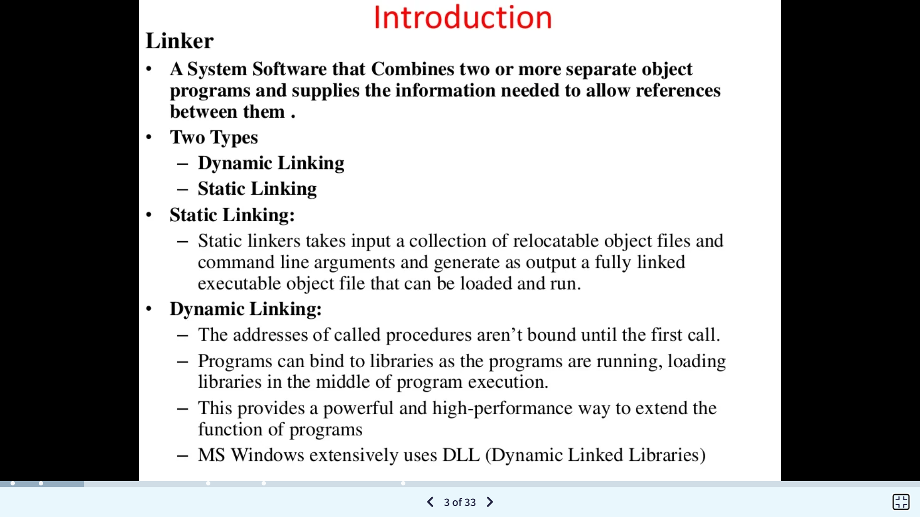

Slide 5
Introduction:
Source program
Translator
Translator translates source program to machine code and creates object file.
Linker receives set of object files and links them solving external reference problems and creates ready to execute file.(which is a binary file).
Loader loads this binary file to execution area for its execution
.Obj
Linker
.exe
Loader
Program execution

Slide 6
Some terminology used to refer to programing address
Translation time address :address assign by translator
Linked address : address assign by linker
Load time address: address assign by loader

Slide 7
Same terminology as assigning the origin of program
Translated origin : Address of origin assumed by the translator.
This address is specified by ORIGIN.
Linked address: Address of origin assign by the linker while generating binary program
Load origin : Address of origin assign by the loader while loading program for execution.

Slide 8
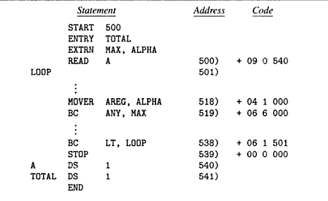
Assembly language program and its generated code

Slide 9
Relocation and linking
Let AA be set of absolute addresses used in the program P.
If AA!= Φ implies that program P assumes that instructions and data occupy specific addresses. a such program is called address sensitive program.
Address sensitive programs can execute correctly only if start address is same as translated origin. To execute correctly , addresses must be corrected.

Slide 10
Program relocation
It is the process of modifying the addresses used in asi of a program such that the program can execute correctly from the designated area of memory
Relocation can be done by the linker or loader
If linked origin != translated origin then relocation is done by linker
If load origin!= linked origin then relocation is done by loader
In general linker performs relocation.

Slide 11
Relocation factor=l_originp - t_origin (1)
If statement uses symbol as an operand,then
tsymb=t_origin+dsymb
dsymb is the offset of a program
For link symbol
Lsymb = l_origin+dsymb

Slide 12
Lsymb=t_origin +relocation factor+dsymb
=t_orgin +dsymb+relocation factor
=tsymb+relocation factor
IRR=Instructions requiring relocation.
Ex: Let IRR for prog P has dispalcement(dsymb)=40,t_origin=500,l_origin=900 then
Relocation factor=900-500=400
tsymb=500+40=540;lsymb=900+40=940
lsymb=540+400=940

Slide 13
Linking
Linking: Linking is a process of binding an external reference to the correct link time address
An Application Program AP consists of a set of program unit SP={x}
Suppose that prog. x interact with other prog. y by using address of y’s instruction and data of its own.
This interaction contains public def. and ext ref.
Public definition: a symbol defined in a program unit which may be referenced in other program units.
Ext. ref : a ref to a symbol which is not defined in the program unit containing the references.

Slide 14
Assembly language program and its generated code

Slide 15
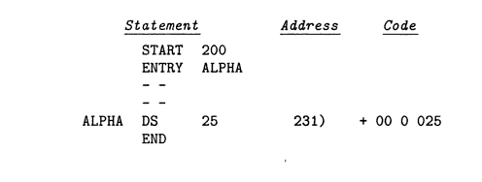
Ad

Slide 16
Absolute loader
Absolute loader doesn’t need to perform functions like linking and program relocation.
For example take assembly language example of Simplified Instructional Compute (SIC) instruction as shown in figure.
All functions are accomplished in a single pass assembler
First the header record is checked to verify that correct program has been represented for loading.
Input is read ,when the end record is encountered the loader jumps to the specified address to begin the execution of the loaded program.

Slide 17
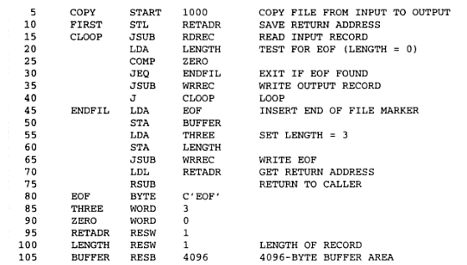

Slide 18
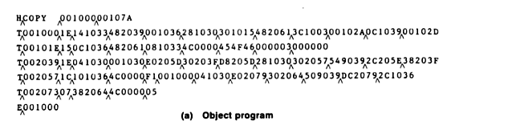

Slide 19
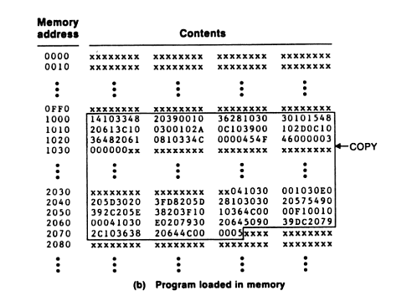

Slide 20
Bootstrap loader
Alternatively referred to as bootstrapping, bootloader, or boot program, a bootstrap loader is a program that resides in the computers EPROM, ROM, or other non-volatile memory that automatically executed by the processor when turning on the computer.
The bootstrap loader reads the hard drives boot sector to continue the process of loading the computers operating system.

Slide 21
When a computer is first turned on or restarted, a special type of absolute loader, called bootstrap loader is executed
This bootstrap loads the first program to be run by the computer -- usually an operating system

Slide 22
Binary programs
It is machine language program contains a set of program units (SP) such that for all Pi belongs to SP
i) Pi has been relocated to the memory area starting at link origin
ii) Linking has been performed for each external reference
To create binary program from object modules linker invocation is required
Linker<link origin>,<object module name>[,<execution start address>]

Slide 23
Design of linker:
Object module: It contains all information necessary to relocate and link the program. It consists of following elements:
1)Header:Contains translated origin ,size and execution start addtress of program.
2)Program:Contains the machine code corresponding to program.
3)RELOCTAB: Descibes IRR.It cntains single field:translated address.
4)LINKTAB(Symbol,Type,translated address):Contains information concerning public definitions.
Type:PD/EXT

Slide 24
Design of linker:
Object module header
T_origin | size | Exe_start_address
500 | 42 | 500
LINKTAB
RELOCTAB
Symbol | Type | Translated address
ALPHA | EXT | 518
MAX | EXT | 519
TOTAL | PD | 541
Translated Address
500
538

Slide 25
Design of linker: Relocation algorithm:
1.program_linked_origin:=<link origin>
2.For each object module
a)t_origin:=translated origin of the object module.
OM_size:=size of the object module;
b)relocation_factor:= program_linked_origin - t_orgin;
c)Read the m/c lang. prog. In work area;
d)Read RELOCTAB of the object module
e)For each entry in RELOCTAB
i)Translated_addr:=Address in theRELOCTAB entry
ii)Addr_in _work_area:=Addr_of _work_area+Translated_addr-t_orgin;
iii)Add relocation_factor to the operand address in the word with the addr. in work area.
f) program_linked_origin:= program_linked_origin+OM_size;

Slide 26
Ex: Let addr in work area=300,
Link origin=900,t_origin=500 ,size=42 then
Relocation factor=900-500=400
Addr_in _work_area=300+500-500=300
This word contains the instruction for
READ A
It is relocated by adding 400 to the operand address in it.

Slide 27
Design of linker: Linking algorithm:
1.program_linked_origin:=<link origin>
2.For each object module
a)t_origin:=translated origin of the object module.
OM_size:=size of the object module;
b)relocation_factor:= program_linked_origin - t_orgin;
c)Read the m/c lang. prog. In work area;
d)Read LINKTAB of the object module
e)For each entry in LINKTAB with type=PD
i)name:=symbol;
linked_address:=translated_address+relocation factor;
Enter(name,linked_address)in NTAB
f)Enter(object module name,Prog_linked_origin)in NTAB
g)Program_linked_origin:=Program_linked_origin+OM_size;
3.For each object module
a)t_origin:=translated origin of the object module
program_linked_origin:=load address from NTAB;
b)For each LINKTAB entry with type=EXT
i)Addr_in_work_area:=Addr of work area+Program_linked_origin- Link_origin+translated addr. –t_orgin;
ii)Search symbol in NTAB and copy its linked address. Add this linked address to operand address in the word with the address with address_in_work_area.

Slide 28
LINKTAB
Symbol | Type | Translated address
ALPHA | EXT | 518
MAX | EXT | 519
TOTAL | PD | 541
NTAB
Symbol | Linked address
Total | 941
P | 900
Q | 942
Alpha | 973

Slide 29
SELF
Non relocating programs
RELOCATION PROGRAMS
is a program which cannot be executed in any memory area other than area starting on its translated origin
Relocatable program Can be processed to relocate it to a desired area of memory
Self- relocating programs
Program which can perform the relocation of its own
address sensitive instructions.
It Contains
A table of information concerning address sensitive instructions
Code to perform relocation of ASI. This is called relocating logic

Slide 30
Linking for overlays
An overlay is a part of a program which has same load origin as some other part of the program
Used to reduce memory requirements of the program
Program containing overlays is called overlay
structured program.
It consists of
1 Permanently resident portion, called root
2 Set of overlays

Slide 31
First root is loaded and given control for execution
Other overlays are loaded when its needed.
Loading new overlay overwrites old overlays coz we have same load origin for all overlays
The structure of program is designed by identifying mutually exclusive modules i.e modules do not call each other.
Sould be avoided to reside simultaneously in memory.

Slide 32
Ex
Program with six section name as init, read ,prog_a,prog_b , prog_c and print.
How overlay is done for this program..?
All the programs are loaded in the main memeory for execution. Sometimes complete program is loaded into the memory, but some times a certain part or routine of the program is loaded into the main memory only when it is called by the program, this mechanism is called Dynamic Loading, this enhance the performance.

Slide 33
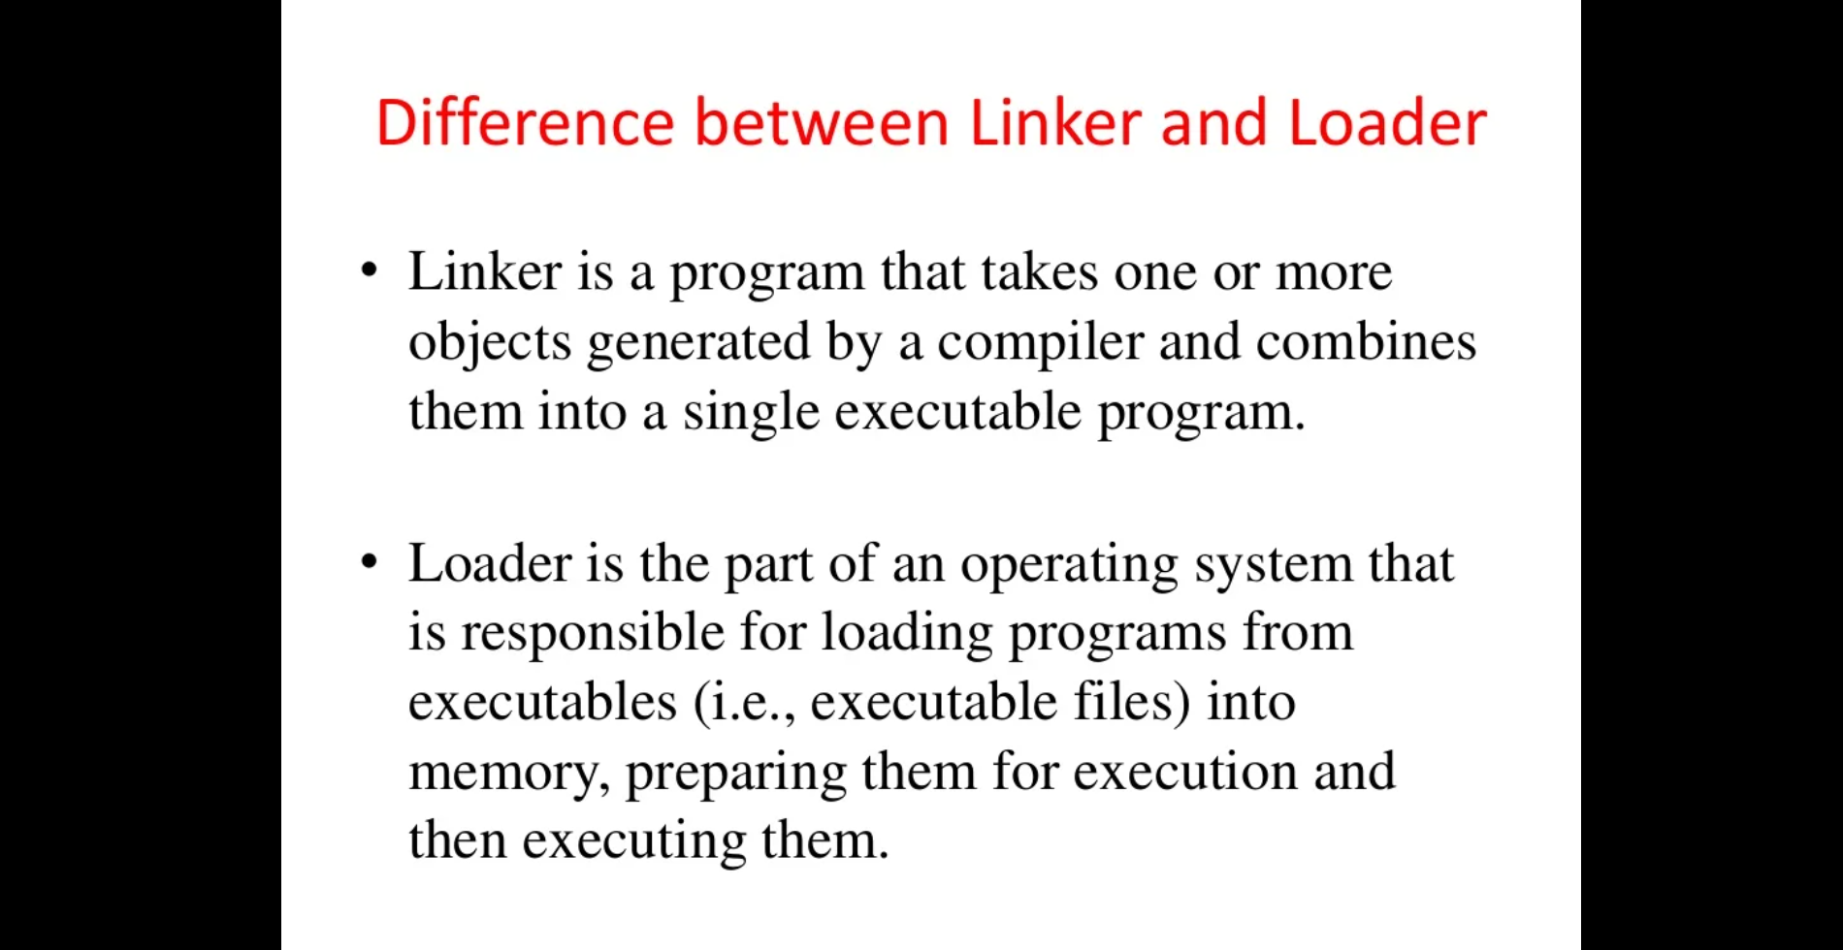

Slide 34
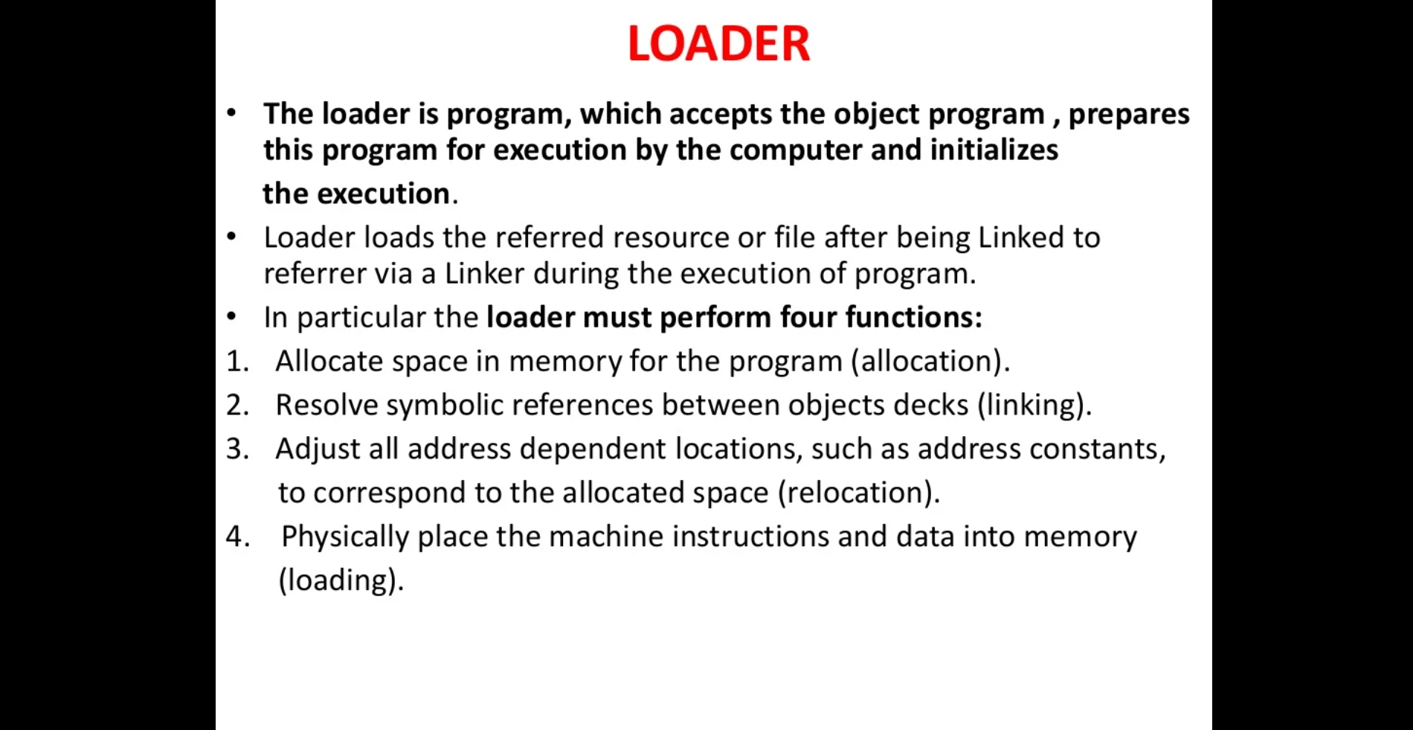

Slide 35
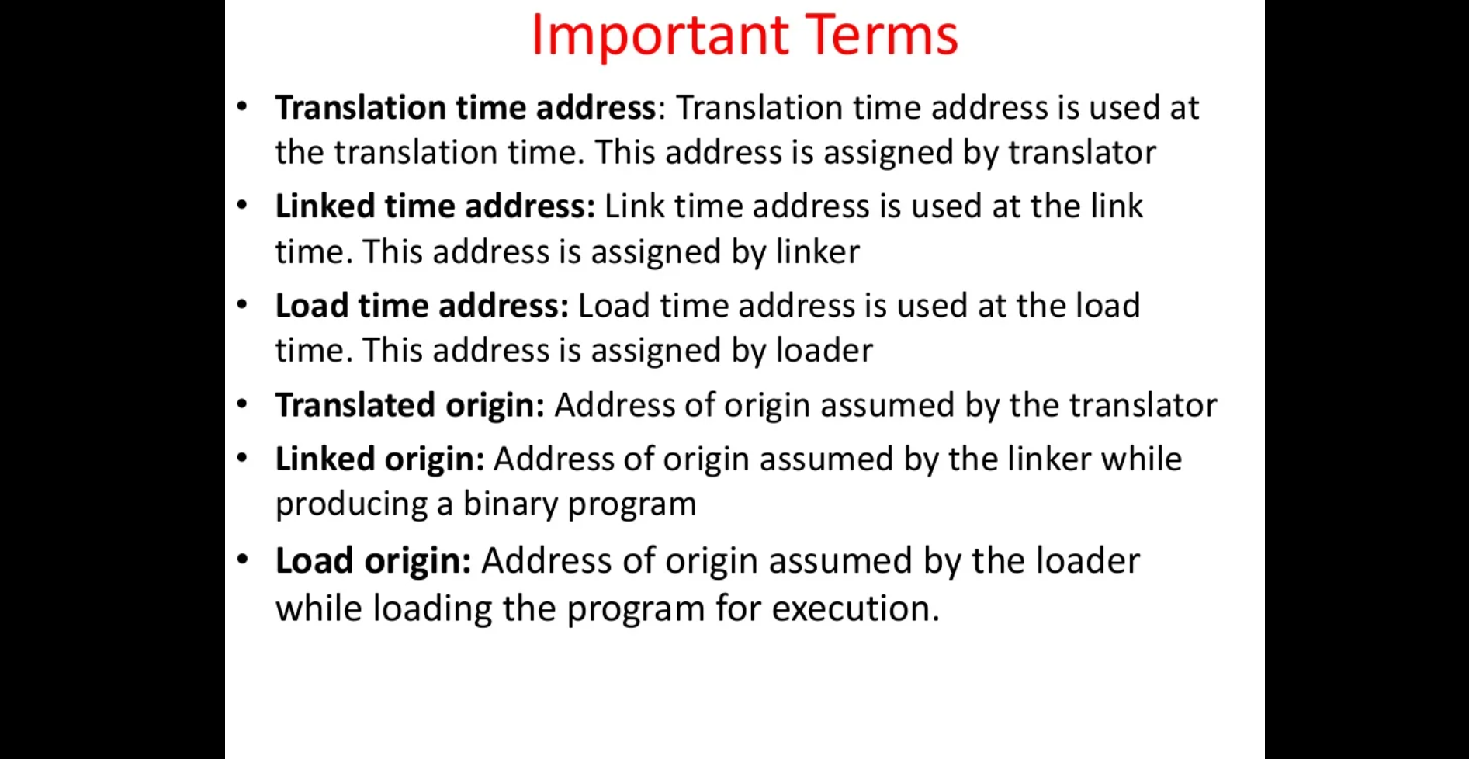

Slide 36
Compilers and Interpreters
“Compilation”
Translation of a program written in a source language into a semantically equivalent program written in a target language
Input
Source
Program
Compiler
Target
Program
Error messages
Output

Slide 37
What is a compiler?
A compiler is a program translates (or compiles) a program written in a high-level programming language (the source language) that is suitable for human programmers into the low-level machine language (target language) that is required by computers.
During this process, the compiler will also attempt to spot and report obvious programmer mistakes that detect during the translation process.

Slide 38
Why we use high-level language for programming?
Using a high-level language for programming has a large impact on how fast programs can be developed. The main reasons for this are:
Compared to machine language, the notation used by programming languages is closer to the way humans think about problems.
The compiler can spot some obvious programming mistakes.
Programs written in a high-level language tend to be shorter than equivalent programs written in machine language.
The same program can be compiled to many different machine languages and, hence, be brought to run on many different machines.

Slide 39
Compilers and Interpreters (cont’d)
“Interpretation”
Performing the operations implied by the source program
Source
Program
Interpreter
Output
Input
Error messages

Slide 40
Compiler vs. Interpreter
Compiler
Interpreter
Take single instruction as input
It is Slower
No intermediate code is generated
Required less memory As no intermediate code is generated
Every time higher level program is converted into lower level program.
Errors are displayed for every instruction interpreted.
Debugging is easy.
Ex: python, Ruby, basic.
Takes Entire program as input
It is Faster
intermediate object code is generated.
Required more memory Due to intermediate object code
Program not need compile every time
Errors are displayed after entire program is checked.
Debugging is comparatively hard.
Ex: C, C++.

Slide 41
The Analysis-Synthesis Model of Compilation
There are two parts to compilation:
Analysis determines the operations implied by the source program which are recorded in a tree structure
Synthesis takes the tree structure and translates the operations therein into the target program

Slide 42
Other Tools that Use the Analysis-Synthesis Model
Editors (syntax highlighting)
Pretty printers (e.g. doxygen)
Static checkers (e.g. lint and splint)
Interpreters
Text formatters (e.g. TeX and LaTeX)
Silicon compilers (e.g. VHDL)
Query interpreters/compilers (Databases)

Slide 43
Preprocessors, Compilers, Assemblers, and Linkers
Skeletal Source Program
Preprocessor
Source Program
Compiler
Try for example:
gcc -v myprog.c
Target Assembly Program
Assembler
Relocatable Object Code
Linker
Libraries and
Relocatable Object Files
Absolute Machine Code

Slide 44
Compiler-Construction Tools
Parser generators that automatically produce syntax analyzers from a grammatical description of a programming language.
Scanner generators that produce lexical analyzers from a regular-expression description of the tokens of a language.
Syntax-directed translation engines that produce collections of routines for walking a parse tree and generating intermediate code.
Code-generator generators that produce a code generator from a collection of rules for translating each operation of the intermediate language into the machine language for a target machine.
Data-flow analysis engines that facilitate the gathering of information about how values are transmitted from one part of a program to each other part. Data-flow analysis is a key part of code optimization.
Compiler-construction toolkits that provide an integrated set of routines for constructing various phases of a compiler.

Slide 45
Why learn about compilers?
It is considered a topic that you should know in order to be “well-cultured” in computer science.
A good craftsman should know his tools, and compilers are important tools for programmers and computer scientists.
The techniques used for constructing a compiler are useful for other purposes as well.
There is a good chance that a programmer or computer scientist will need to write a compiler or interpreter for a domain-specific language.

Slide 46
The Evolution of Programming Language
classification by generation
First-generation languages: machine languages
Second-generation : assembly languages
Third-generation : higher-level languages like Fortran, Cobol, Lisp, C, C++, C#, and Java.
Fourth-generation languages: languages designed for specific applications like NOMAD for report generation, SQL for database queries, and Postscript for text formatting.
fifth-generation language has been applied to logic- and constraint-based languages like Prolog and OPS5.

Slide 47
Impacts on Compilers
The advances in programming languages placed new demands on compiler writers.
Compiler writers would take maximal advantage of the new hardware capabilities.
Good software-engineering techniques are essential for creating and evolving modern language processors.
Notes:
The design of programming languages and compilers are intimately related, the advances in programming languages placed new demands on compiler writers. They had to devise algorithms and representations to translate and support the new language features.
Since the 1940's, computer architecture has evolved as well. Not only did the compiler writers have to track new language features, they also had to devise translation algorithms that would take maximal advantage of the new hardware capabilities.
Compilers can help promote the use of high-level languages by minimizing the execution overhead of the programs written in these languages.
Compilers are also critical in making high-performance computer architectures effective on users' applications. In fact, the performance of a computer system is so dependent on compiler technology that compilers are used as a tool in evaluating architectural concepts before a computer is built.
Compiler writing is challenging. A compiler by itself is a large program.
Moreover, many modern language-processing systems handle several source languages and target machines within the same framework; that is, they serve as collections of compilers, possibly consisting of millions of lines of code. Consequently, good software-engineering techniques are essential for creating and evolving modern language processors.
A compiler must translate correctly the potentially infinite set of programs that could be written in the source language. The problem of generating the optimal target code from a source program is undecidable in general; thus, compiler writers must evaluate tradeoffs about what problems to tackle and what heuristics to use to approach the problem of generating efficient code.

Slide 48
The Phases of a Compiler
Phase | Output | Sample
Programmer | Source string | A=B+C;
Scanner (performs lexical analysis) | Token string | ‘A’, ‘=’, ‘B’, ‘+’, ‘C’, ‘;’ And symbol table for identifiers
Parser (performs syntax analysis based on the grammar of the programming language) | Parse tree or abstract syntax tree | ; | = / \ A + / \ B C
Semantic analyzer (type checking, etc) | Parse tree or abstract syntax tree
Intermediate code generator | Three-address code, quads, or RTL | int2fp B t1 + t1 C t2 := t2 A
Optimizer | Three-address code, quads, or RTL | int2fp B t1 + t1 #2.3 A
Code generator | Assembly code | MOVF #2.3,r1 ADDF2 r1,r2 MOVF r2,A
Peephole optimizer | Assembly code | ADDF2 #2.3,r2 MOVF r2,A

Slide 49
The Grouping of Phases
Compiler front and back ends:
Analysis (machine independent front end)
Synthesis (machine dependent back end)
Passes
A collection of phases may be repeated only once (single pass) or multiple times (multi pass)
Single pass: usually requires everything to be defined before being used in source program
Multi pass: compiler may have to keep entire program representation in memory

Slide 50
Compiler-Construction Tools
Software development tools are available to implement one or more compiler phases:
Scanner generators
Parser generators
Syntax-directed translation engines
Automatic code generators
Data-flow engines

Slide 51
Interpreters
An interpreter is a language processor which bridges an execution gap without generating a machine language program.
Main component of interpreters are
Data store
Symbol table
Data manipulation routine
Type of interpreter
Pure interpreter
Impure interpreter
Impure interpreter performs some preliminary processing of source program to reduce the analysis overheads during interpretation.

Slide 52
Overview of Interpretation
The interpreter reads the source program and store it in its memory.
The CPU uses the program counter(PC) to note the address of the next instruction to be executed.
The statement would be subjected to the interpretation cycle, which could consist the following steps-
Fetch the instruction
Analyze the statement and determine its meaning, the computation to be performed and its operands.
Execute the meaning of the statements.

Slide 53
What is Debugging?
A programmer can make mistakes while writing a program, and hence, the program may not execute or may generate wrong output. The process of identifying and removing such mistakes, also known as bugs or errors, from a program is called debugging.

Slide 54
Types of Errors
These are types of errors occurring in programs can be categorized as:
Syntax Errors
Logical Errors
Runtime Error

Slide 55
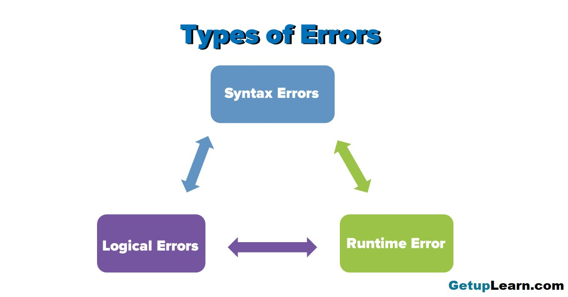

Slide 56
Syntax Errors
Like other programming languages, Python has its own rules that determine its syntax. The interpreter interprets the statements only if it is syntactically (as per the rules of Python) correct. If any syntax error is present, the interpreter shows error message(s) and stops the execution there.
For example, parentheses must be in pairs, so the expression (10 + 12) is syntactically correct, whereas (7 + 11 is not due to the absence of the right parenthesis. Such errors need to be removed before the execution of the program.

Slide 57
Logical Errors
A logical error is a bug in the program that causes it to behave incorrectly. A logical error produces an undesired output but without abrupt termination of the execution of the program. Since the program interprets successfully even when logical errors are present in it, it is sometimes difficult to identify these errors
The only evidence of the existence of logical errors is the wrong output. While working backward from the output of the program, one can identify what went wrong. Logical errors are also called semantic errors as they occur when the meaning of the program (its semantics) is not correct.

Slide 58
Runtime Error
A runtime error causes abnormal termination of program while it is executing. Runtime error is when the statement is correct syntactically, but the interpreter cannot execute it. Runtime errors do not appear until after the program starts running or executing.
For example, we have a statement having division operation in the program. By mistake, if the denominator entered is zero then it will give a runtime error like “division by zero”.

Slide 59
Debugger
Debugging, in computer programming and engineering, is a multistep process that involves identifying a problem, isolating the source of the problem, and then either correcting the problem or determining a way to work around it.

Slide 60
Classofication of debuggers
Static Debugger
Dynamic Debugger
Breakpoint debugger
Meta debugger
Kernel debugger
Tele debugger
Debugger with same process
Debugger with separate process

Slide 61
Java Language Environment
Java development kit
Javac - the java compiler
Java – the java interpreter
Jdb – the java debugger
Appletviewer – tool to run the applets
Javap – to print the java byecodes
Javaprof – java profiler
Javadoc – documentation generator
Javah – creates C header files

Slide 62
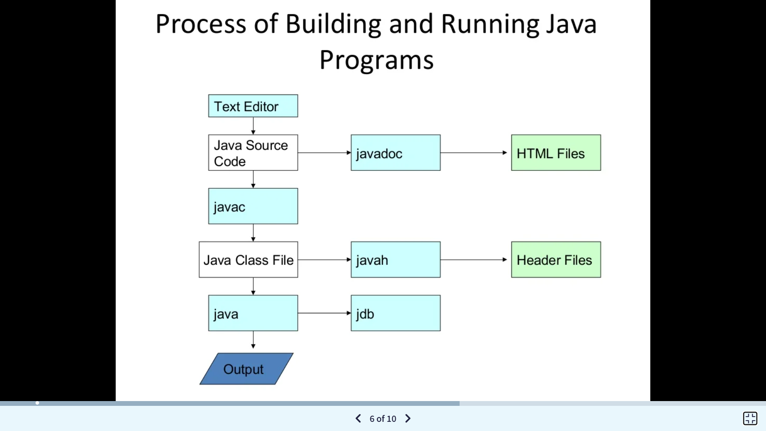

Slide 63
Java Virtual Machine(JVM)
JVM (Java Virtual Machine) is an abstract machine. It is a specification that provides runtime environment in which java bytecode can be executed.
JVMs are available for many hardware and software platforms (i.e. JVM is platform dependent).
What is JVM
A specification where working of Java Virtual Machine is specified. But implementation provider is independent to choose the algorithm. Its implementation has been provided by Oracle and other companies.
An implementation Its implementation is known as JRE (Java Runtime Environment).
Runtime Instance Whenever you write java command on the command prompt to run the java class, an instance of JVM is created.

Slide 64
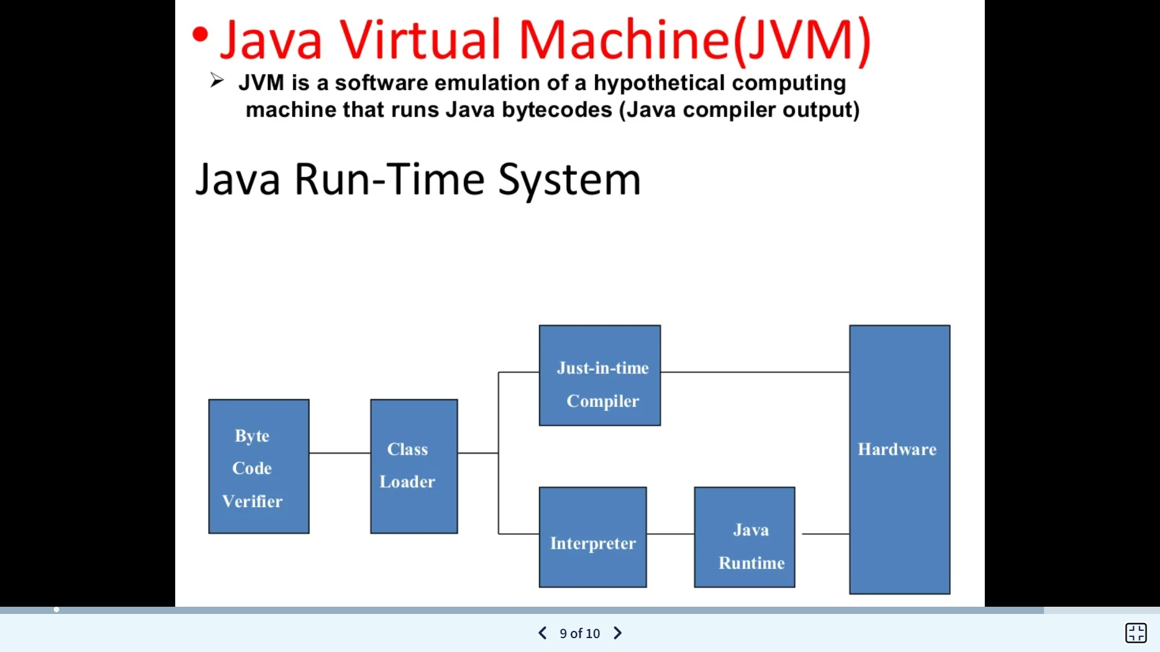

Slide 65
Java Runtime Environment
The Java Runtime Environment, or JRE, is a software layer that runs on top of a computer’s operating system software and provides the class libraries and other resources that a specific Java program needs to run.
The JRE is one of three interrelated components for developing and running Java programs. The other two components are as follows:
The Java Development Kit, or JDK, is a set of tools for developing Java applications. Developers choose JDKs by Java version and by package or edition—Java Enterprise Edition (Java EE), Java Special Edition (Java SE), or Java Mobile Edition (Java ME). Every JDK always includes a compatible JRE, because running a Java program is part of the process of developing a Java program.
The Java Virtual Machine, or JVM, executes live Java applications. Every JRE includes a default JRE, but developers are free to choose another that meets the specific resource needs of their applications.

Slide 66
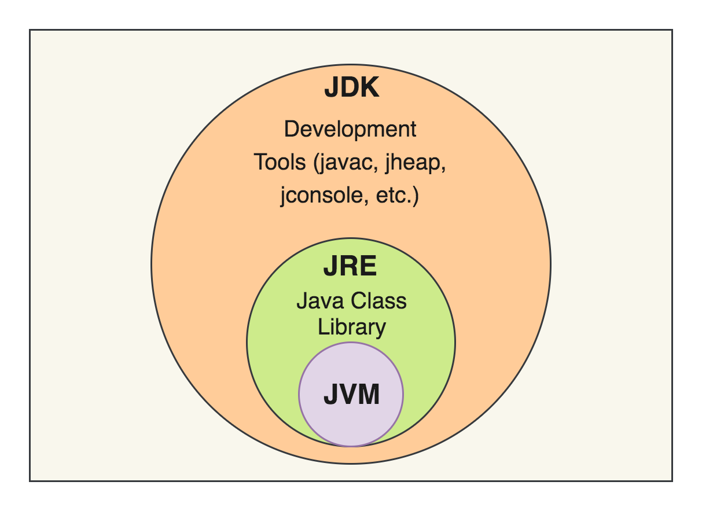
JDK, JRE & JVM

